Slide 1

Assertiveness, Boundaries, & Empowerment
Title IX Internship Proposal
Madison Bird, Seth Meyer, Asral Sanjaa

Slide 2
Our Purpose
Setting Boundaries, being assertive and empowerment all have gender bias associated with them. The purpose of this project is to encourage both male and female students to learn to set healthy boundaries, being assertive in their communications, and empower one another.

Slide 3
Main Issues
Assertiveness
communicating your feelings, thoughts, & beliefs in an open, honest manner without violating the rights of others.
Boundaries
protect your self-esteem, maintain self-respect, & enjoy healthy relationships.
Empowerment
engaging and cooperating with others needs & listening to their ideas, offering feedback, valuing their inputs.

Slide 4
Funnel for project awareness
PROJECT AWARENESS
PHYSICAL POSTERS AROUND CAMPUS
PROJECT DISCOVERY
VISITING INSTAGRAM PAGE
EVENT DISCOVERY
CLICK THE LINK & GO TO OUR WEBSITE
EVENT
COMING TO OUR EVENT
LEARN
LEARNING & APPLYING
WOMM
BECOME TITLE IX ADVOCATE, SHARE WITH FRIENDS

Slide 5
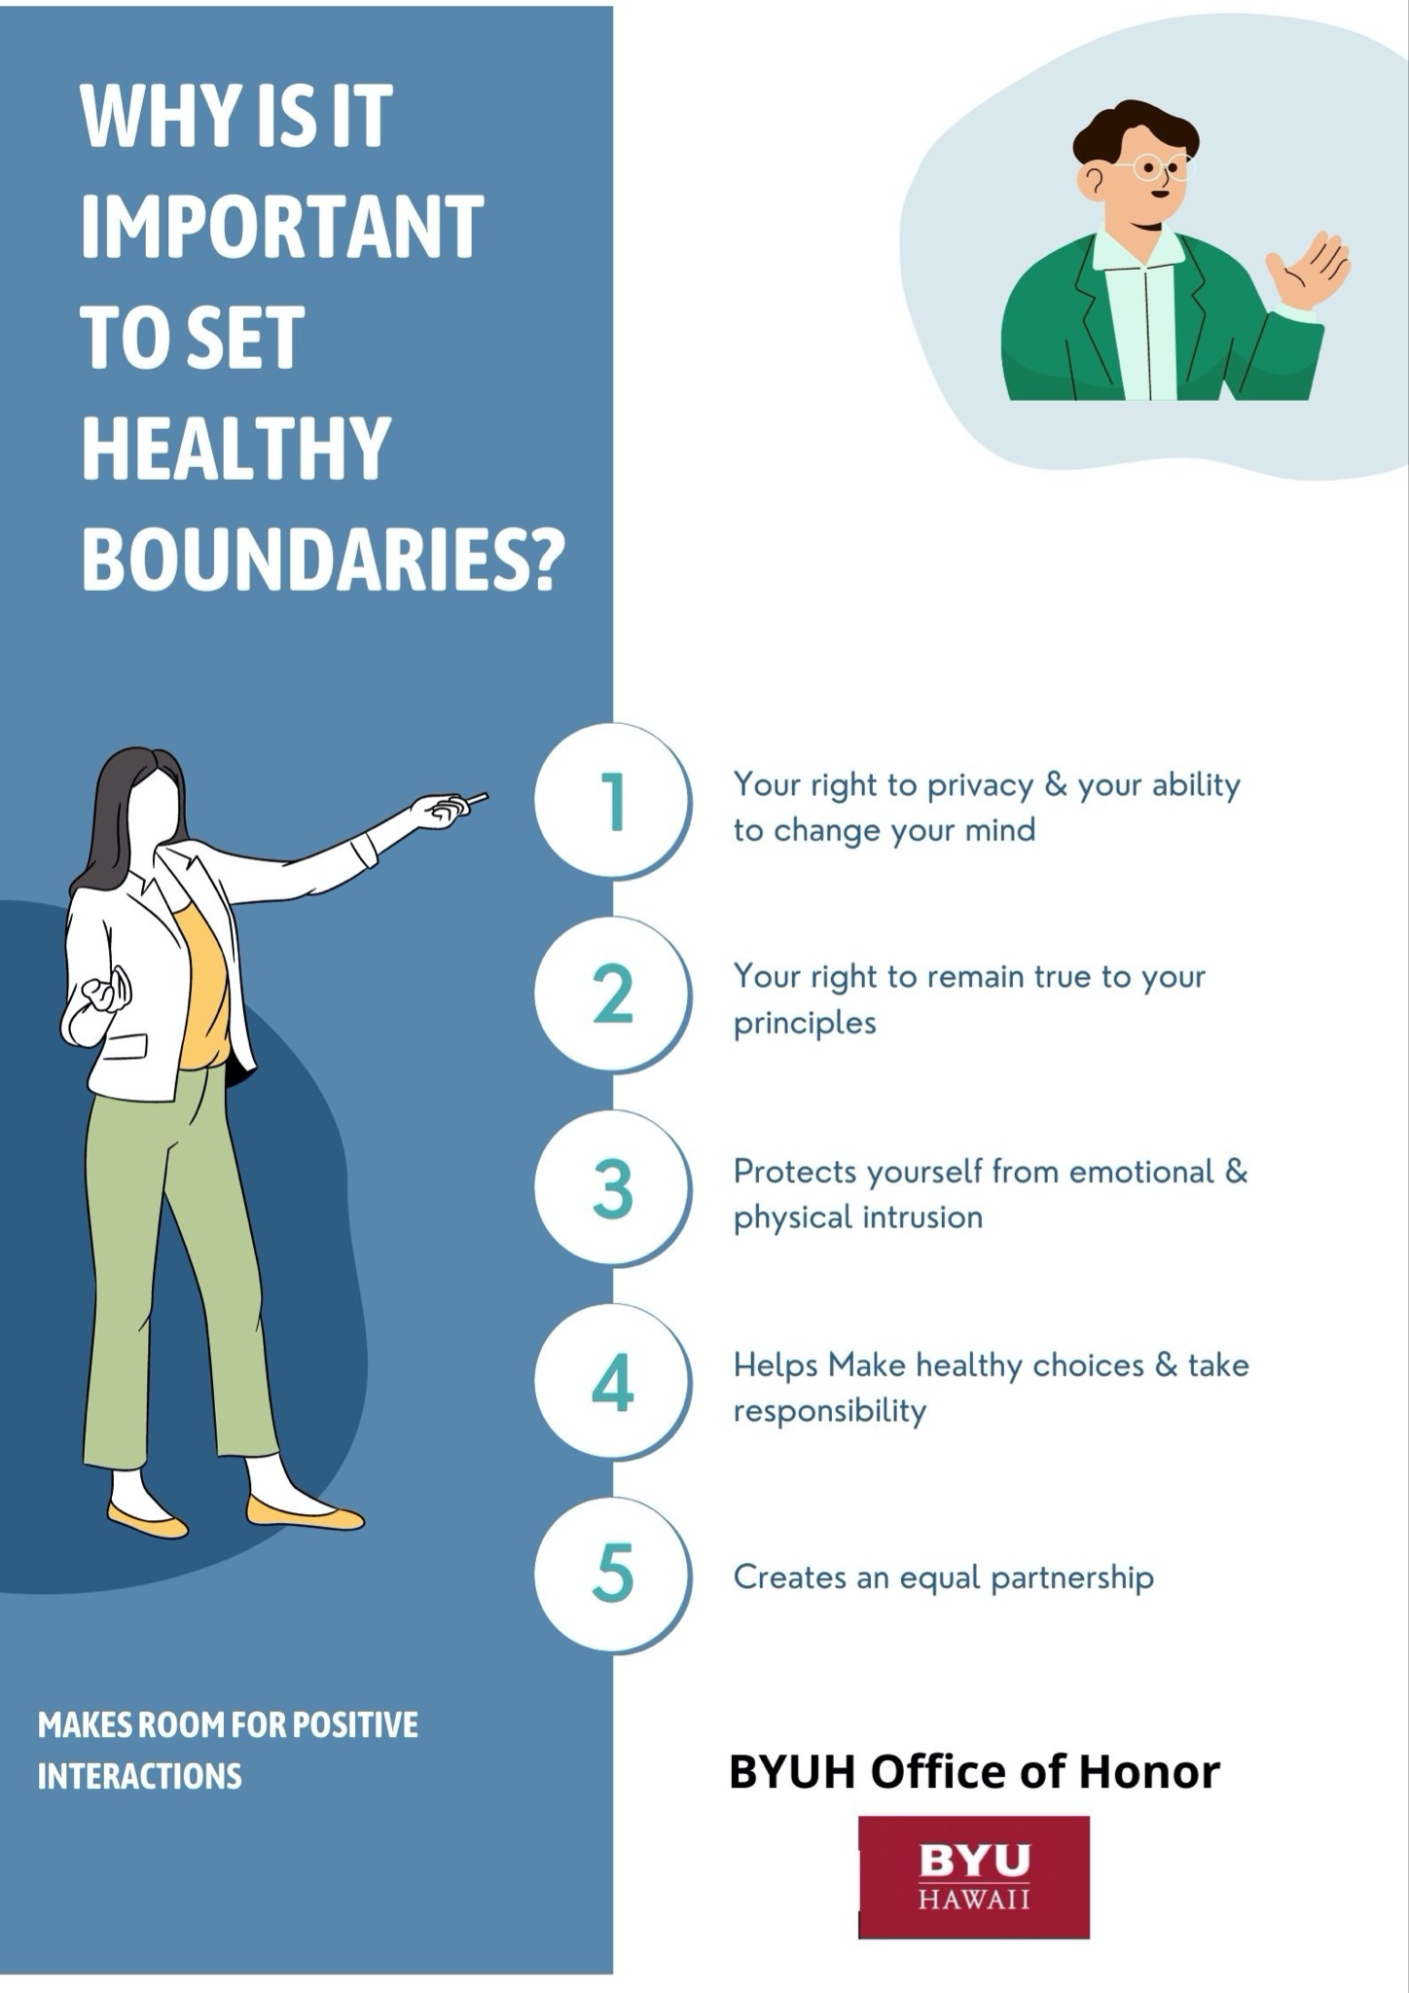
Posters
Promote awareness around campus:
-Aloha Center
-The Quad
-Hales

Slide 6
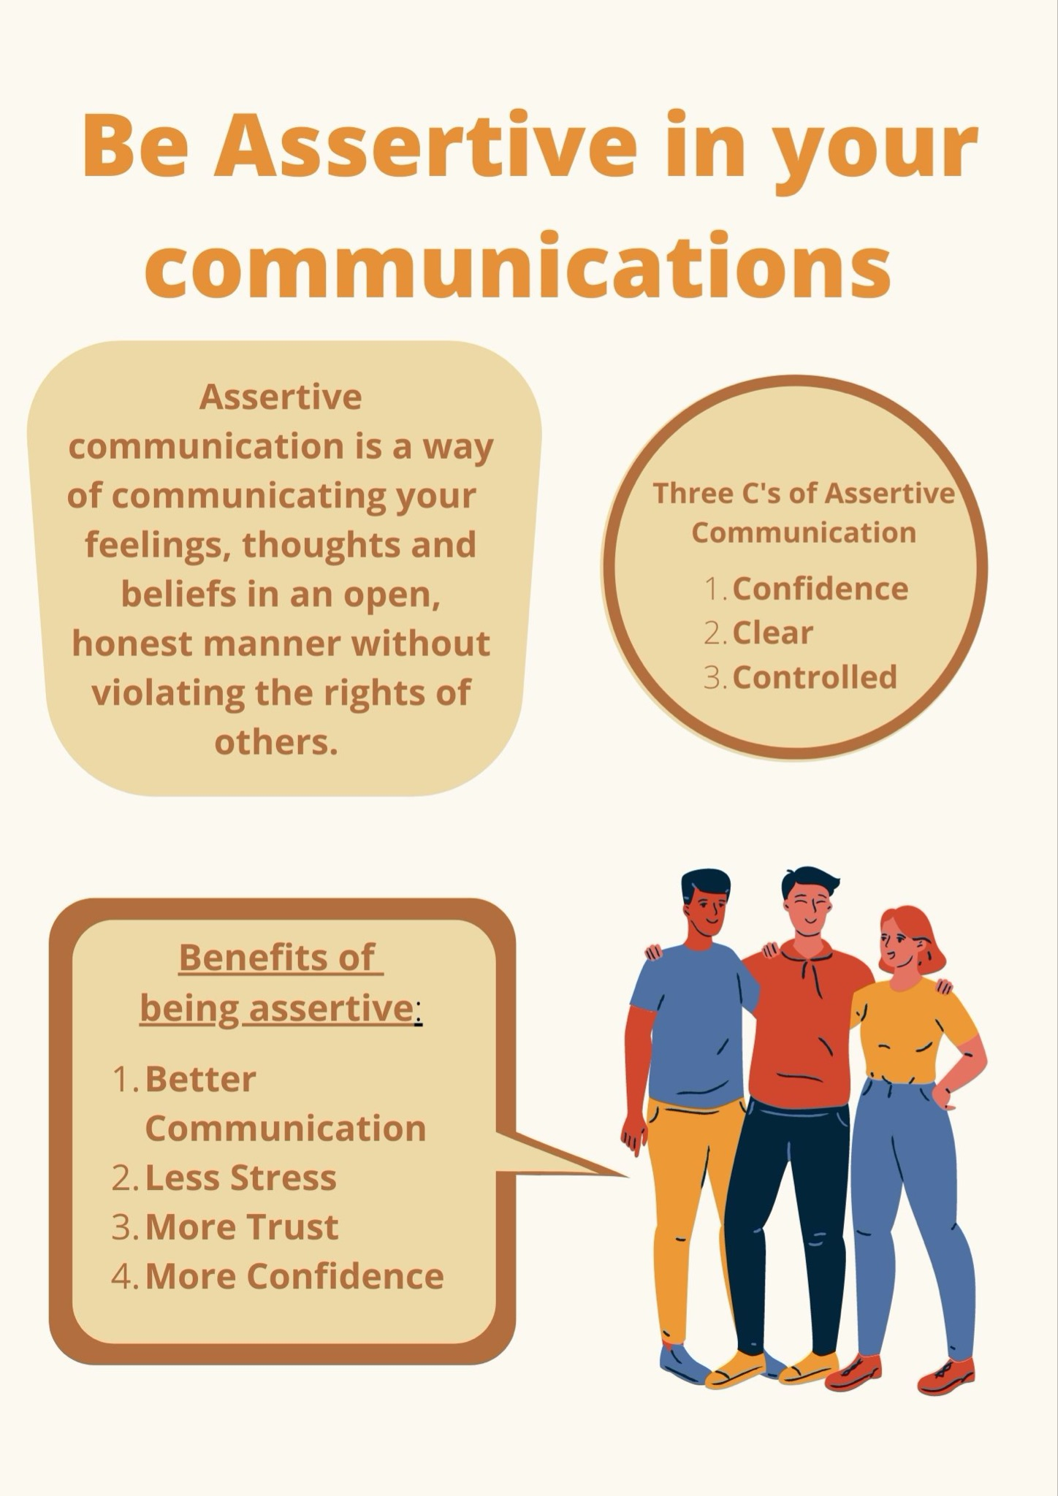
Posters
Promote awareness around campus:
-Aloha Center
-The Quad
-Hales

Slide 7

Instagram–Caption
Gender Discrimination goes beyond pay differences and job offers, it is also more prominent in certain industries. Recognizing the need for a change is the first step in creating a environment actively fighting sexism.
Have you seen any recent breakthroughs in gender discrimination?

Slide 8

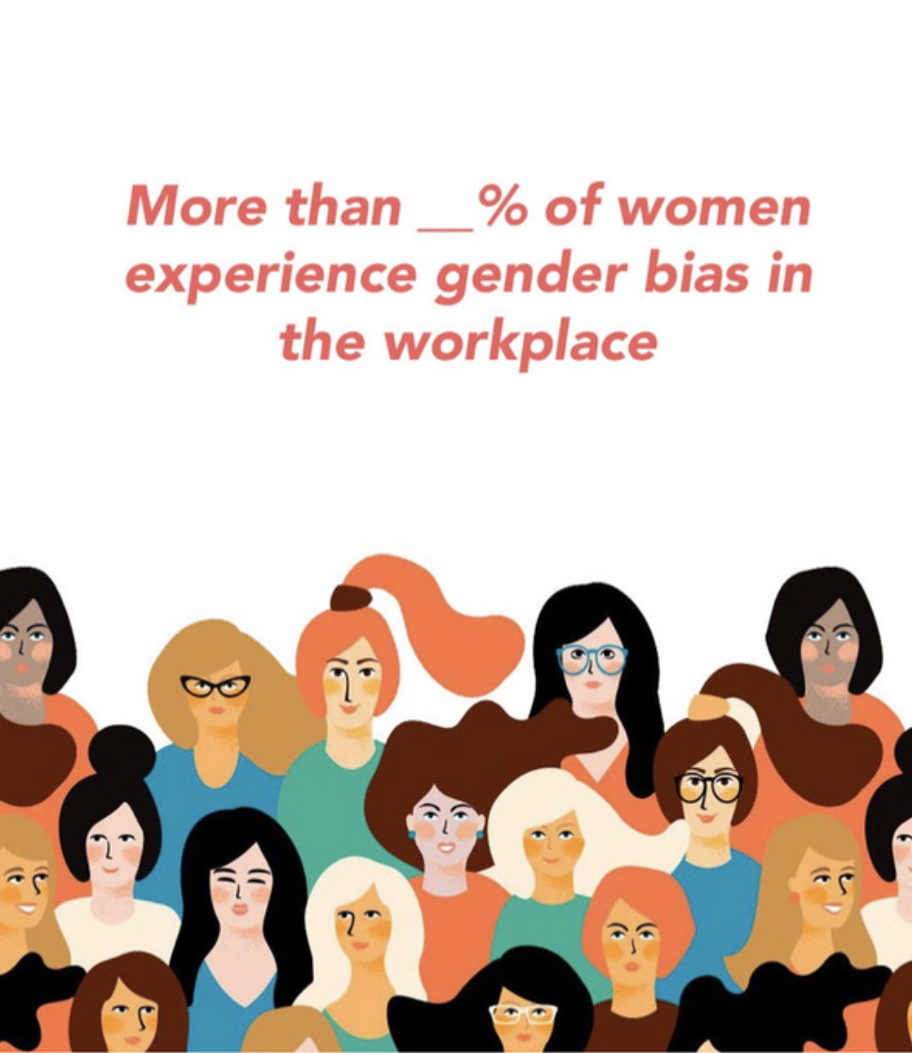
Instagram–Caption
42% of women experience gender discrimination in workplace in the U.S. and it comes in many different forms such as earning less than men in doing the same task. Women with a bachelor’s degree or more education report experiencing discrimination across a range of items at significantly higher rates than women with less education.
What do you think would be a great step towards breaking down discriminatory practices?

Slide 9

Instagram–Caption
Come and learn about Setting Healthy Boundaries, Assertive Communication, and Empowerment at our Title IX event. Games and prizes are waiting for you, so bring your friends!
What do you know about setting healthy boundaries?
Are you familiar with the concept of Empowerment?
Do you want to learn how to express yourself better among peers and at workplace?
We need your participation and feedback to establish a community in which healthy boundaries and women empowerment are encouraged.

Slide 10
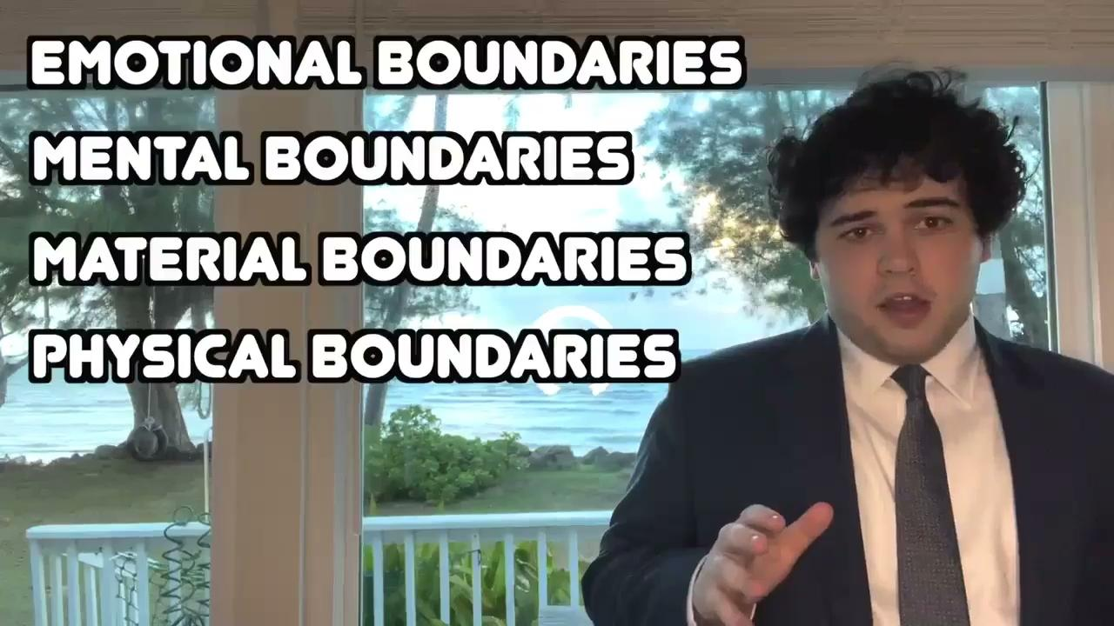

Videos
Short videos that cover important and easy to remember topics of each subject
Boundaries Ex.
Assertiveness Ex.

Slide 11
Our Website
3 clickable links that will take you to more information about that topic.
Boundaries
Assertiveness
Empowerment

Slide 12
Website Content
BOUNDARIES:
Boundary building is a difficult task; more often than not, it is even more challenging to recognize that a boundary needs to be set. Setting healthy boundaries does not make you a bad person; it simply means you are doing what is best not only for yourself but everyone else involved too. Normalizing healthy boundaries is the first step to breaking down bad societal values, like toxic femininity/masculinity, abusive relationships, workplace harassment, domestic abuse, and so much more.
ASSERTIVENESS:
“Never feel bad for being assertive, speaking your mind, and putting your foot down. What you think is anger, others see as a good solid display of self-esteem.” -Alison Jame
Unfortunately, opinions matter to us, but that shouldn’t be what stops us from asserting ourselves. It is not our job to manage what other people think of us; instead, create a vision or a goal to achieve. At the end of the day, the only opinion about yourself that matters is your own, don’t be afraid to create a space that empowers your decisions.
EMPOWERMENT:
There’s something so special about a woman who dominates in a man’s world. It takes a certain grace, strength, intelligence, fearlessness, and the nerve to never take no for an answer.” -Rihanna
Women every day are breaking boundaries, and they are a force to be reckoned with. Empowering young women opens doors for generations to come and allows for opportunities previously out of reach. Change starts in ourselves and by supporting each other, by creating an environment accepting of change.

Slide 13
Event Description
Purpose
a metaphorical and interactive activity about creating strong boundaries. Within the boundaries, students will then deal with prompts to practice assertiveness and empowerment
Supplies
-Foam Blocks
-Ping Pong Balls
-Foam Balls
-Empowerment Trophy
-Candy (incentive/reward)

Slide 14
Event Roadmap
Create website, Hang up posters around campus, Put out initial social media posts
Continue with posters, promotions, and instagram posts
Start using videos now
Event!!
1
3
5
2
4
6
Start promotion for event
Poll students for ideas
Promote event now with one week left
Gather supplies
Follow up with photos from event and what was learned

Slide 15
Thank You

